Slide 1






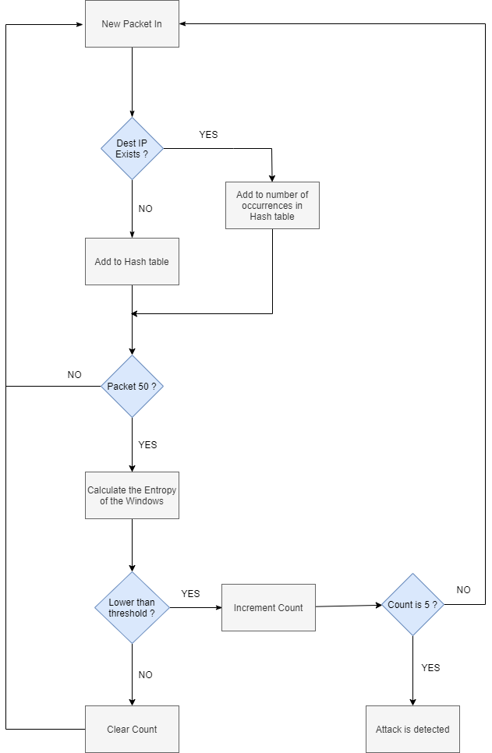
Group No.: 107
Name: Ankit
Mentor: Dr. Gitanjali Chandwani
Roll No.: 101815169
DDoS Attack Detection in SDN using Entropy
Introduction
SDN network provide predictability, manageability and good quality of service by separates data plane and control plane. With increasing cyber attacks, importance of security provision in centralized managed SDN network has become one of the main concerns.
Procedure
Technologies Used
Result
We succesfully implemented sample entropy method to detect DDoS attacks in the first 250 packets of traffic as minimum and 500 packets maximum. This solution is not only efficient in detection, it has minimal code addition to the controller program and does not increase CPU load in either normal or attack condition.
Objectives
Analysing the behaviour of DDoS attacks on the SDN environments by the means of sample entropy.
Implementing a mechanism for early detection of DDoS Attacks in SDN.
Future Scope
DDoS attacks detection in the multi-controller SDN structure.
Mitigation of the DDoS attacks in the SDN environment.

